Slide 1
OBD TOOL

Slide 2

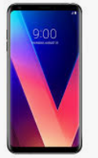
OBD TOOL OVERVIEW
OBD BOARD
ST MICOM
CAN_H
CAN_L
CAN
TRANCEIVER
USB
* STM32F103RCT6
CAN DATA → PARSING transfer DATA FORMAT
TO DO LIST (FOR OBD-BOARD)
CAN PORT enable
USB Driver enable(to communicate with smartphone)
Save attached file (CAN DATA format)
Send CAN DATA to smartphone using USB port
Make protocol format between OBD board and smartphone API

Slide 3
OBD OVERVIEW
TO DO LIST (FOR Android Application)
USB Data communication
(Need to make USB speed (over than CAN 500Kbits/sec))
Setting menu
Display CAN DATA
Display Check PID (Turn signal,Brake, Accelerator,RPM,Speed,Steering Wheel)
Save DATA ( To use can information data base)

Slide 4
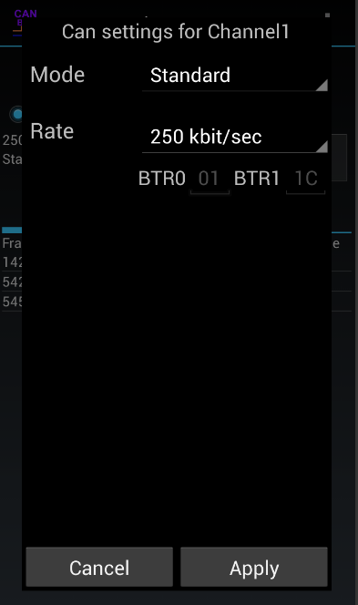
Android Application
Can Settings
Mode : Standard(Normal) / Broadcast(Silent)
2. Baudrate : 250K /500K
3. CHANGE1 : HEX/DECIMAL/BINARY
CHANGE2 : NIBBLE CHANGE
BYTE
WORD(HIGH BYTE)
WORD(LOW BYTE)
HEX/DECIMAL/BINARY
NIBLE CHANGE
BYTE
WORD(HIGH BYTE)
WORD(LOW BYTE)

Slide 5
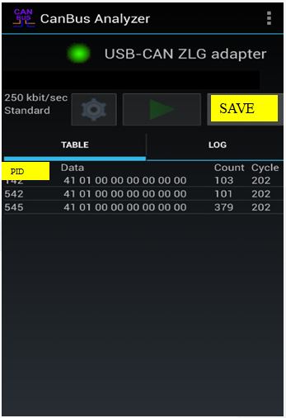
Android Application
Can Settings
* HEX/DECIMAL/BINARY
* 1BYTE
* NIBLE CHANGE
* WORD(HIGH BYTE)
* WORD(LOW BYTE)
In case of Speed( 20km/h)
Display data value(red color) hex/1byte
Display data value(red color) decimal/word(low byte)
….
Display data value(red color) binary/word(high byte)
Data file save function

Slide 6
Android Application
In case of Car Speed →20Km/h
41 01 00 00 14 00 00 00
*1BYTE
HEX → 41 01 00 00 14 00 00 00
BINARY →
00100001 00000001 00000000 00000000 00000000 00000000 00000000 00000000
00000001 00000100 00000000 00000000 00000000 00000000 00000000 00000000
DECIMAL 65 01 00 00 20 00 00 00
* WORD(HIGH BYTE)
HEX → 4101 0000 1400 0000
BINARY →
00100001000000010000000000000000 00000000000000000000000000000000
00000001000001000000000000000000 000000000000000000000000 00000000
DECIMAL 16641 00000 05120 00000

Slide 7
Android Application
In case of Car Speed →20Km/h
41 01 00 00 14 00 00 00
*NIBBLE CHNAGE
HEX → 14 10 00 00 41 00 00 00
BINARY →
00000001 00000100 00000001 00000000 00000000 00000000 00000000 00000000
00000100 00000001 00000000 00000000 00000000 00000000 00000000 00000000
DECIMAL 20 16 00 00 65 00 00 00
*WORD(LOW BYATE)
HEX → 0141 0000 0014 0000
BINARY →
00000001000001000000010000000001 00000000000000000000000000000000
00000000000000000000000100000100 000000000000000000000000 00000000
DECIMAL 00321 00000 00020 00000

Slide 8
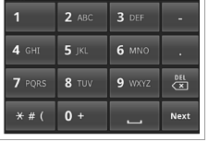
Android Application
PID INPUT Method
PID Number define(301, 304, 305)
PID Number range define
(300-320)
PID : If we input PID , Display PID data only input range pid (142,542,545)

Slide 9
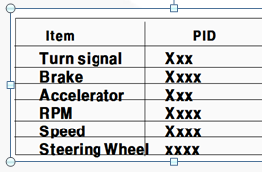
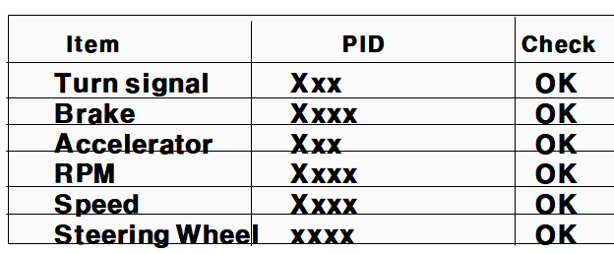
Android Application
If we use this tools many times,
we know a lots of PID (below items)
We would like to check below items
Base on PID data base.

